Slide 1
Blog application
Cloud-Based Blog Application Using AWS

Slide 2
Cloud-Based Blog Application Using AWS
Project Title: Cloud-Based Blog Application Using AWS
platform: Aws Cloud Computing – DevOps
Presented By: PEDDINTI SaiKrishna (22MH1A4944)
ASAPU KARTHIK (22MH1A4906)
BAILAPUDI MALLIKA (22MH1A4907)
ARAVA VASANTHI (22MH1A4905)
MAKINEEDI AKSHAYA (22MH1A4933)
Internship Organization: APSSDC
College: Aditya College of Engineering and Technology
Department: CSE -INTERNT OF THINGS

Slide 3
Objectives
Build a full-stack blog application
A simple blog web application deployed on AWS using Elastic Beanstalk
Deploy the application on AWS infrastructure
Uses MongoDB for data storage and S3 for image storage
Built with EJS templates and Bootstrap for styling.
Ensure scalability, performance, and availability
Provide a clean, simple, and intuitive user interface

Slide 4
Features Implemented
User Authentication & Authorization (JWT-based)
Create, Read, Update, Delete (CRUD) blog posts
Image upload & retrieval from Amazon S3
Comments feature on blog posts
Responsive UI using Bootstrap
Dynamic rendering using EJS

Slide 5
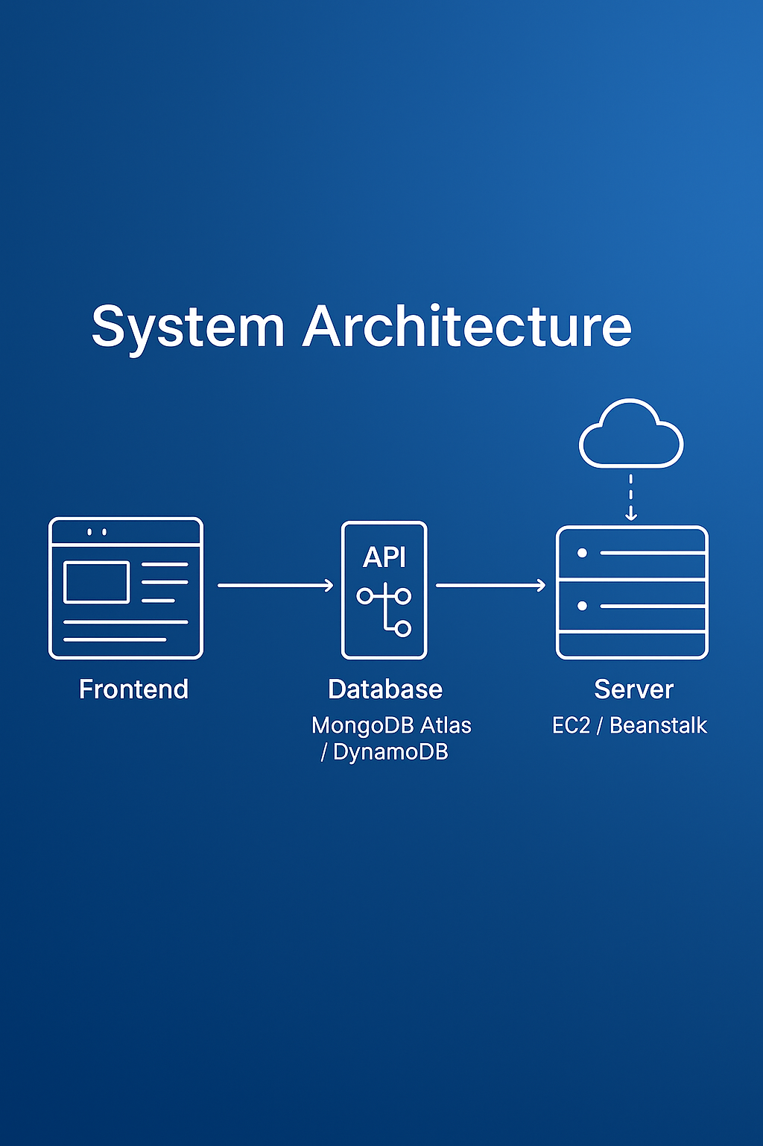
Architecture Diagram
[Client Browser]
|
v
[Frontend Layer: EJS Templates + Bootstrap]
|
v
[Backend Server: Node.js + Express.js]
|
|---> [MongoDB Atlas]
| - Stores blog posts
| - Stores user accounts and comments
|
|---> [Amazon S3 Bucket]
| - Stores uploaded blog images
| - Returns image URLs for rendering in blogs
|
v
[AWS Elastic Beanstalk (Hosting Platform)]
- Deploys and manages the Express.js app
- Handles environment scaling, health monitoring
- Integrates with S3 and MongoDB Atlas

Slide 6
Technology Stack
Frontend: EJS , BOOTSTRAP
Backend: Node.js + Express
Database: MongoDB Atlas
Image Store: Amazon S3
Cloud : AWS Elastic Beanstalk
Authentication & Authorization: JWT

Slide 7
AWS Services Used
Elastic Beanstalk: Auto-scaling and managing server environment.
Amazon S3: Stores and serves image files securely.
IAM: Grants permissions to access S3 securely.
MongoDB Atlas: Cloud-hosted document database.

Slide 8
Application Workflow
User registers/logs in
Authenticated user creates blog post
Image uploaded to S3 bucket
Blog content saved in MongoDB
Blog rendered via EJS with Bootstrap
Users can view & comment on posts

Slide 9
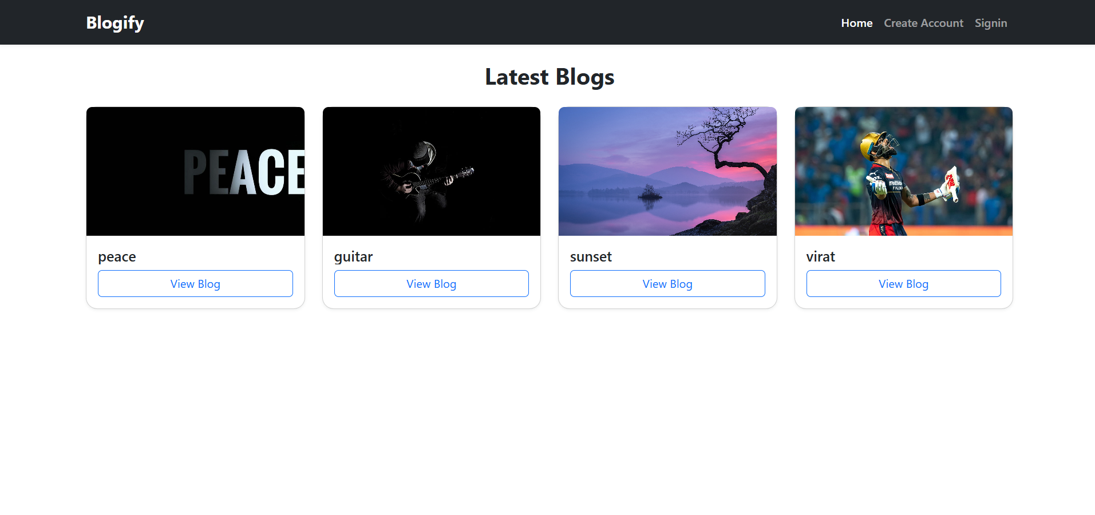
HOME PAGE

Slide 10
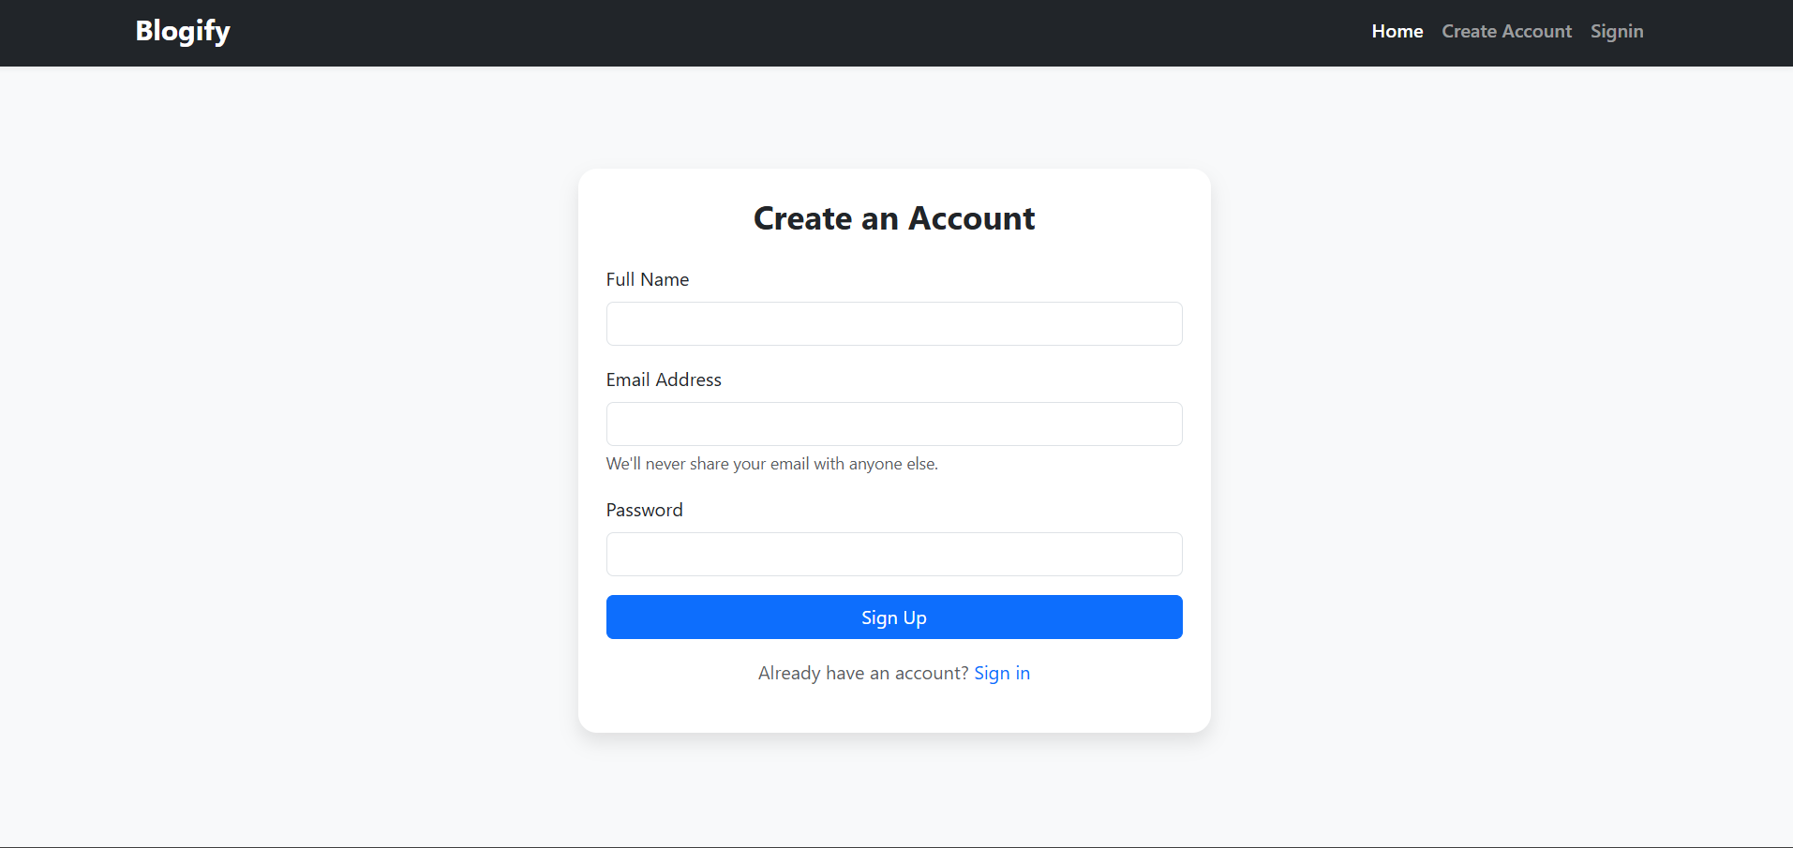
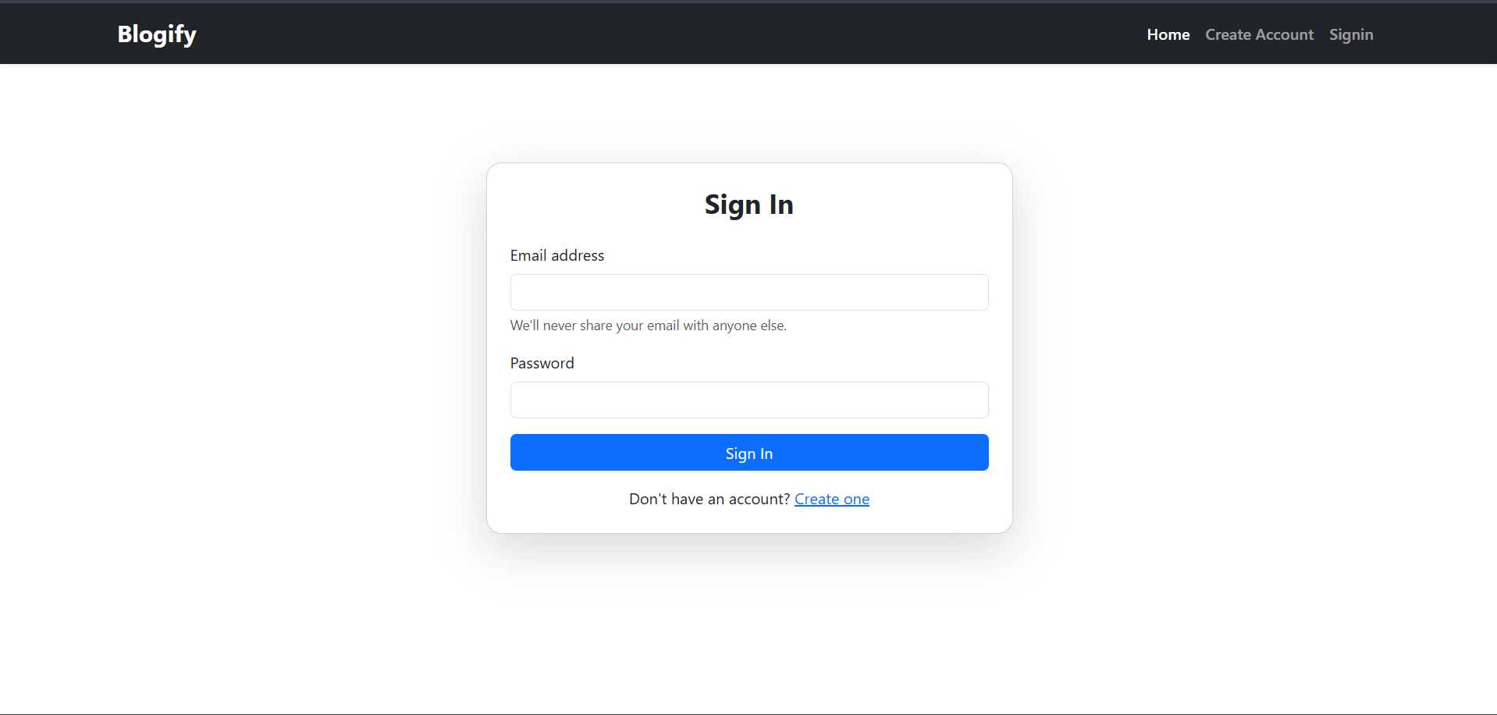
SIGN UP & LOGIN

Slide 11
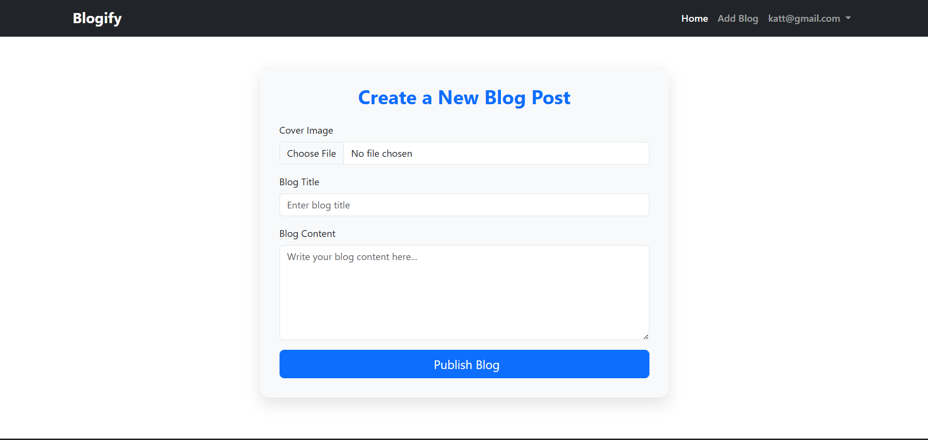
Create a New Blog Post

Slide 12
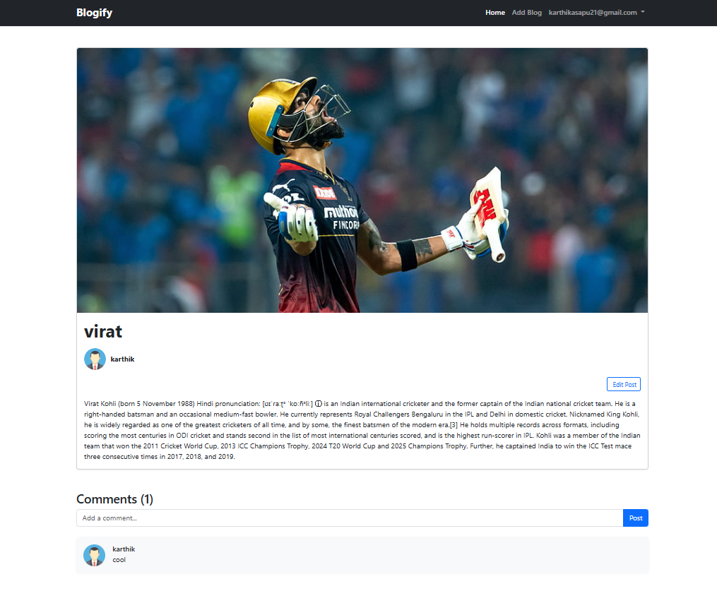
Blog view page

Slide 13
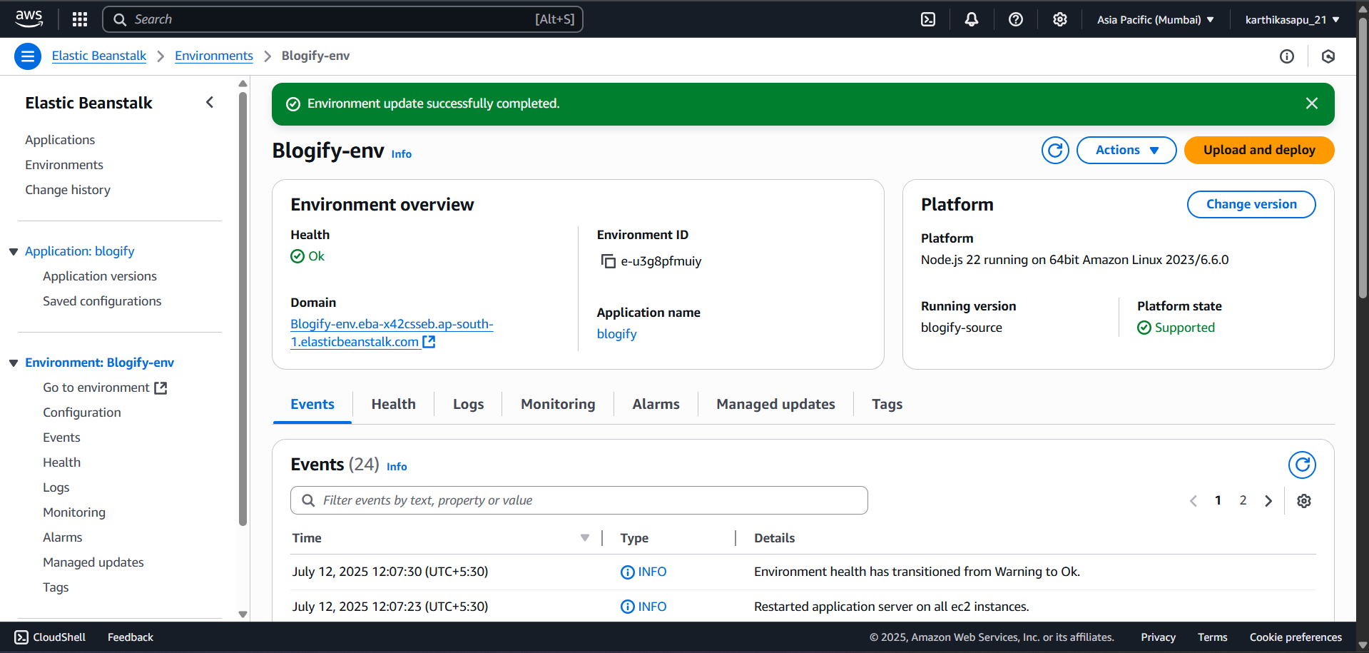
ELASTIC BEANSTALK

Slide 14
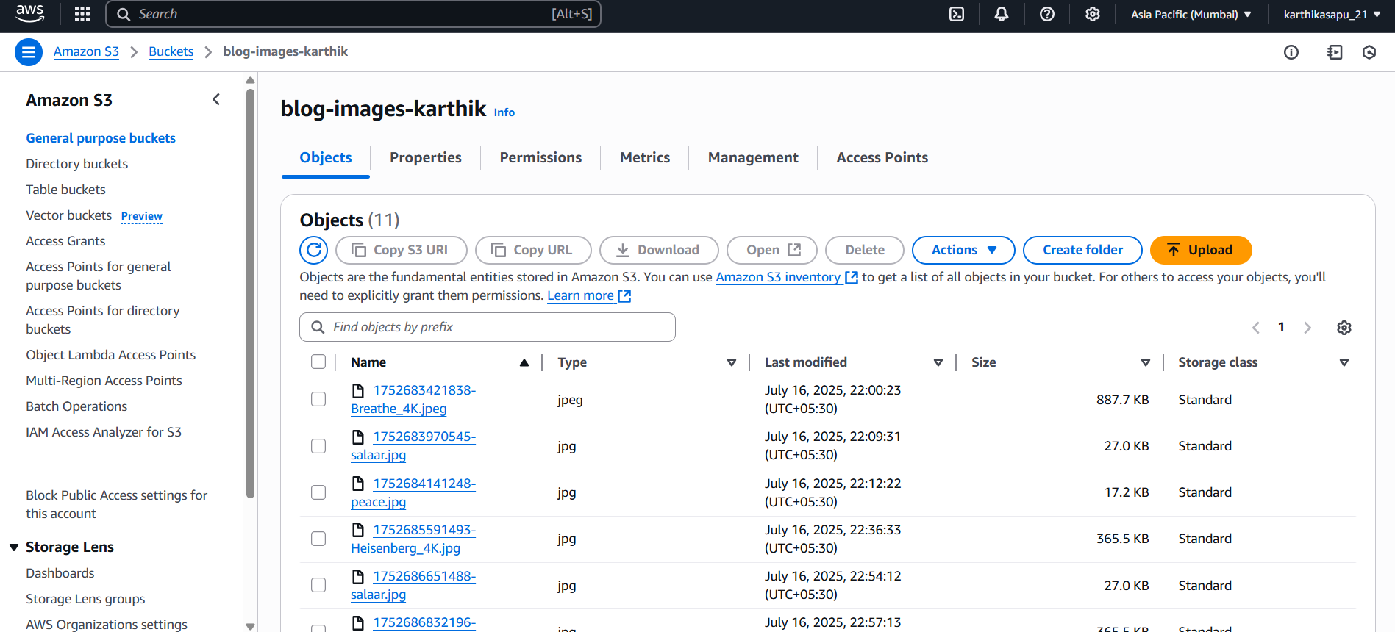
S3 Bucket with stored images

Slide 15
Conclusion
Cloud helps scale and secure web applications
Successfully deployed a full-stack blog app using AWS.
Demonstrated modular design and secure architecture.
Leveraged scalable cloud services like Beanstalk and S3

Slide 16
THANK YOU !!!

